Slide 1


Green Pace
Security Policy Presentation
Developer: Michelle Lewis

Slide 2

OVERVIEW: DEFENSE IN DEPTH
Defense-in-depth is a comprehensive security strategy that layers multiple defenses by integrating people, technology, and operational capabilities. This ensures that if one defense is compromised, additional layers provide continued protection. Adopting this strategy enhances an organizations resilience to cyberthreats (defense-in-depth – Glossary, n.d.).

Slide 3
THREATS MATRIX
Likely Flaws introduced by ignoring rule have higher chances of leading to an exploitable vulnerability. | Priority Rule violations that could lead to high severity consequences should be repaired first.
Low priority Rule violations that have a low severity consequence have a lower repair priority. | Unlikely Flaw introduced by ignoring rule not likely to lead to an exploitable vulnerability.
Source: (Carnegie Mellon University, 2016)

Slide 4
10 PRINCIPLES (with coding standards that apply to each)
Validate Input Data
Guarantee that storage for strings has sufficient space for character data and the null terminator
Prevent SQL injection
Do not attempt to create a std::string from a null pointer
Range check element access
Heed Compiler Warnings
Architect and Design for Security Policies
Guarantee exception safety
Keep It Simple
Never qualify a reference type with const or volatile
Default Deny
Do not access freed memory
Adhere to the Principle of Least Privilege
Do not read uninitialized memory
Sanitize Data Sent to Other Systems
Avoid information leakage when passing a class object across a trust boundary
Prevent SQL injection
Practice Defense in Depth
Avoid information leakage when passing a class object across a trust boundary
Use Effective Quality Assurance Techniques
Guarantee that storage for strings has sufficient space for character data and the null terminator.
Incorporate diagnostic tests using assertions
Do not attempt to create a std::string from a null pointer
10. Adopt a Secure Coding Standard
Guarantee exception safety

Slide 5
CODING STANDARDS (in priority order)
Guarantee that storage for strings has sufficient space for character data and the null terminator. (P18 - High)
Prevent SQL injection (P18 - High)
Do not access freed memory (P18 - High)
Do not attempt to create a std::string from a null pointer (P18 - High)
Do not read uninitialized memory (P12 - High)
Guarantee exception safety (P9 - Medium)
Range check element access (P6 - Medium)
Never qualify a reference type with const or volatile (P3 - Low)
Avoid information leakage when passing a class object across a trust boundary (P1 - Low)
Incorporate diagnostic tests using assertions (P1 - Low)

Slide 6
ENCRYPTION POLICIES
[Explain the policies for encryption in flight, at rest, and in use.]
Encryption at rest | This is the practice of encrypting data that is stored on a physical device (Encryption Explained: At Rest, in Transit & End-To-End Encryption | Splunk, n.d.). Implement a strong encryption algorithm such as AES-256 to encrypt sensitive data before it is stored. This protects the data of the company and its clients from unauthorized access if the storage device is stolen or lost.
Encryption in flight | This is the practice of protecting data that is being transmitted over a network. This prevents data from being intercepted during transit (Encryption Explained: At Rest, in Transit & End-To-End Encryption | Splunk, n.d.). Utilize secure protection protocols such as HTTPS, TLS, and SSL to encrypt data before it is sent over the internet or other network. Apply AES algorithm for additional security. Encryption in flight prevents data breaches during data transmission and maintains trust with clients.
Encryption in use | This is the practice of encrypting data that is actively being accessed and processed in a database or cloud service environment (Velimirovic, 2023). Implement cryptographic technology such as fully homomorphic encryption (FHE). Utilize trusted execution environments (TEEs) such as Intel SGX.

Slide 7
TRIPLE-A POLICIES
Authentication | Confirm the user’s identity before granting access to the system.
Authorization | Dictates what authenticated users are permitted to access and activities they are permitted to do.
Accounting | Keeps a meticulous record of who has accessed a system and what actions were taken.

Slide 8
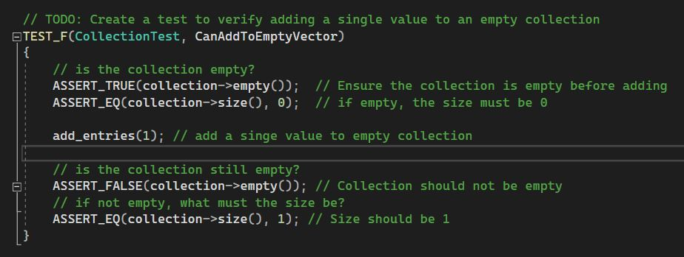
Unit Test 1: Can you add to an empty vector?
Positive Test
Results:

Slide 9
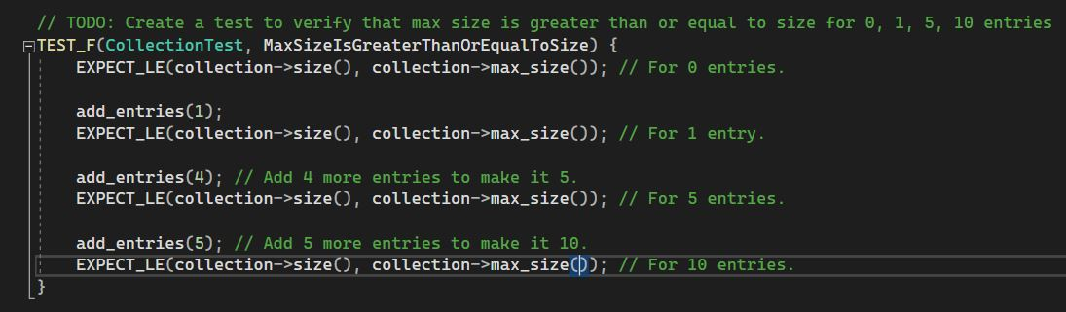
Unit Test 2: Is the Max Size Greater Than or Equal to Size?
Positive Test
Results:

Slide 10
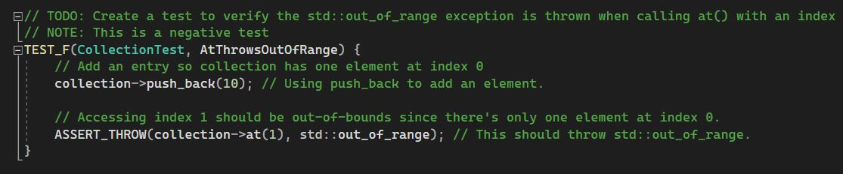
Unit Test 3: Is Exception Thrown When Out of Range?
Negative Test
Results

Slide 11
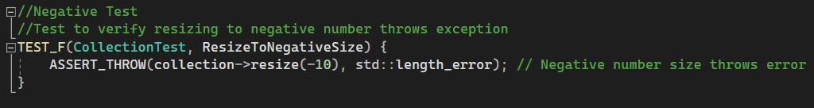
Unit Test 4: Does Resizing to a Negative Size Throw an Error?
Negative Test 2
Result

Slide 12

AUTOMATION SUMMARY

Slide 13
TOOLS
The DevSecOps pipeline integrates security into each stage of the software development lifecycle instead of implementing it only towards the end of a project. This secure by design approach ensures the development of an application that can resist modern cyberattacks.
Pre-Production Tools
Assess and Plan- Threat Modeling
Design- Tools for checking secure design patterns
Build- Version Control Systems (i.e. Git), Static Analysis tools (i.e. SonarQube)
Verify and Test- Dynamic Analysis Tools
Production Tools
Transition and Health Check- Automated deployment tools, Automated Penetration testing
Monitor and Detect- SIEM systems and intrusion detection systems
Respond- Automated tools that isolate affected systems
Maintain and Stabilize- Automated tools apply security patches

Slide 14
RISKS AND BENEFITS
Problems
Learning Curve to developers learning new security tools
Current systems may need to be updated to be compatible with security tools
Solutions
Invest in professional training for all developers to learn DevSecOps and how to use security tools.
Roll out changes gradually to help staff adapt to changes
Invest in current systems that are compatible with modern security tools
Risks
Security breaches
Data breaches
Reputation- Loss of trust from clients
Benefits
Implementing now helps transition quicker to the modern DevSecOps method
DevSecOps practices make us competitive
Develop more secure applications

Slide 15
RECOMMENDATIONS
Comprehensive secure development standards can be found here: https://wiki.sei.cmu.edu/confluence/
A structured training schedule aligned with the DevSecOps rollout is essential
Stay up-to-date with security practices as new threats emerge and current practices could become obsolete
Adopting DevSecOps practices can prevent future problems
Example: 2017 Equifax data breach resulted from failure to patch vulnerability (Bomey, 2020)

Slide 16
CONCLUSIONS
Stay up-to-date with evolving threats
OWASP Top 10 website: https://owasp.org/www-project-top-ten/
NIST Cybersecurity Framework: https://www.nist.gov/cyberframework

Slide 17
REFERENCES
Bomey, N. (2020b, February 11). How Chinese military hackers allegedly pulled off the Equifax data breach, stealing data from 145 million Americans. USA TODAY. https://www.usatoday.com/story/tech/2020/02/10/2017-equifax-data-breach-chinese-military-hack/4712788002/
Encryption explained: At rest, in transit & End-To-End encryption | Splunk. (n.d.). Splunk. https://www.splunk.com/en_us/blog/learn/end-to-end-encryption.html
Software Engineering Institute, Carnegie Mellon University. (2016)SEI CERT C Coding Standard: Rules for Developing Safe, Reliable, and Secure Systems34. Carnegie Mellon University. https://resources.sei.cmu.edu/downloads/secure-coding/assets/sei-cert-c-coding-standard-2016-v01.pdf
(n.d.). defense-in-depth - Glossary | CSRC. https://csrc.nist.gov/glossary/term/defense_in_depth
OWASP Top Ten | OWASP Foundation. (n.d.). https://owasp.org/www-project-top-ten/
Positive Testing vs Negative Testing | Scenarios & Approaches. (2024, February 1). Testsigma Blog. https://testsigma.com/blog/positive-and-negative-testing-scenarios/
Velimirovic, A. (2023, November 16). Data encryption in use explained. phoenixNAP Blog. https://phoenixnap.com/blog/encryption-in-use

